Slide 1
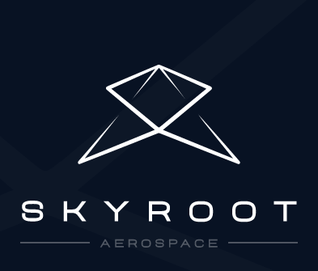
PRESENTATION ON SKYROOT
BY S.V.RAJMOHAN

Slide 2
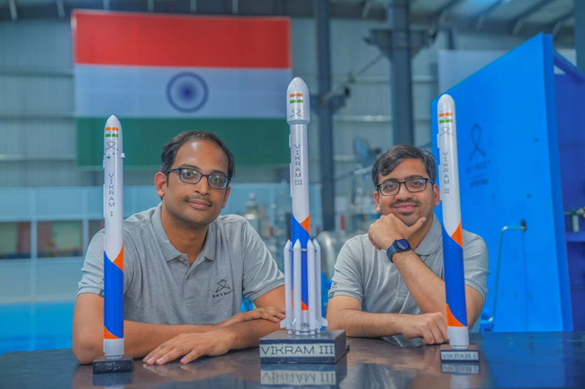
WHAT IS SKYROOT?
Skyroot Aerospace is one India’s privately owned and operated space organisations.
The company’s headquarters is located in Hyderabad.
The company was founded by two former ISRO scientists, Pawan Kumar Chandana and Naga Bharath Daka.
The company was founded in 2018.

Slide 3
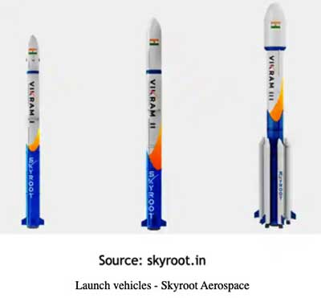
AMBITION
Skyroot’s main ambition is to open space for all by making spaceflight more affordable, reliable and regular.
they plan to achieve this with the Vikram series of rockets.
The Vikram series includes 4 types of rockets, the Vikram-I, the Vikram-II, the Vikram-III and the Vikram-S
The 4 rockets have various specifications for, orbit height, payload capacity, thrust, thrust to weight ratio etcetera.

Slide 4
THE VIKRAM SERIES
Vikram - named after Dr. Vikram Sarabhai, founder of the Indian Space Program - is a series of modular Space launch vehicles especially crafted for the small satellite market.
The leading technology architecture of Vikram vehicles offers unique capabilities like multi orbit insertion, interplanetary missions; while providing customized, dedicated and ride share options covering a wide spectrum of small satellite customer needs.
Launching satellites to space will soon become as easy as booking a cab - Quick, precise and affordable!

Slide 5
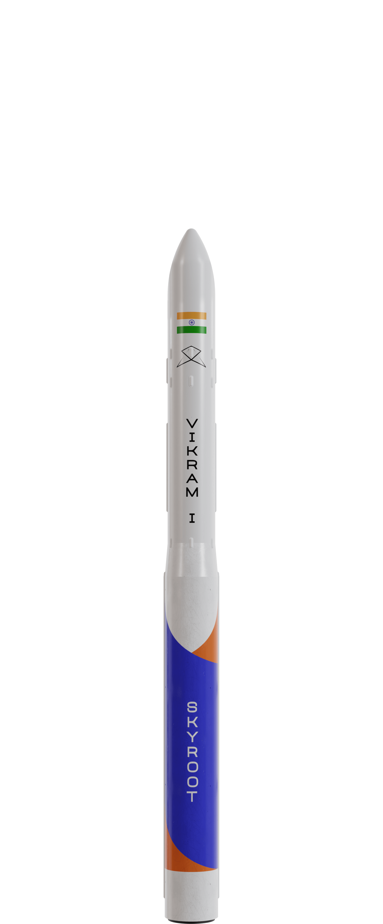
VIKRAM-I
The Vikram-I is the smallest rocket of its class.
It has payload capacity of about 480 kgs.
It is able to put the 480 kg payload in an low inclination orbit having 500km radius.
It is propelled by solid state propulsion systems.
It has miniaturized and modern avionics, Ultra-Lowshock Pneumatic separation, etc.
It offers flexibility by having an orbital adjustment module with restart capabilities which enables multi orbit payload insertion.
It is the cheapest rocket to launch in its class.
It requires minimal range launch setup facilities and can be assembled within 24 hours from any launch site,

Slide 6
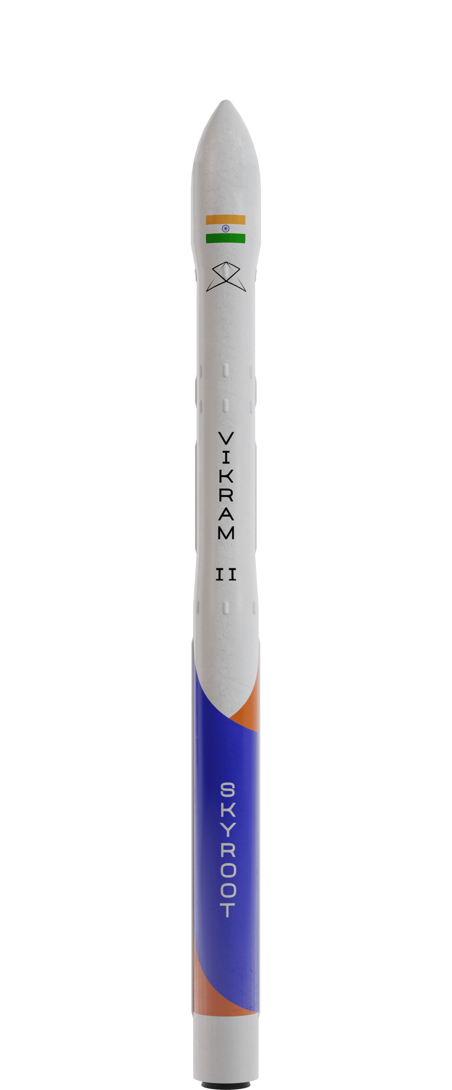
VIKRAM-II
The next version of rockets in the Vikram series is the Vikram-II
It has a payload capacity of 595 kgs.
It is able to put this 595 kg payload in an low inclination orbit having 500km radius.
It has the same reliable solid state propulsion system as that of the Vikram-I for the lower stage propulsion.
It has an advanced cryogenic methalox engine for upper stage propulsion.
The upper stage propulsion system has restart capabilities.
This enables multiorbital insertion of the payload
It requires minimal range launch setup facilities and can be assembled within 72 hours from any launch site.

Slide 7
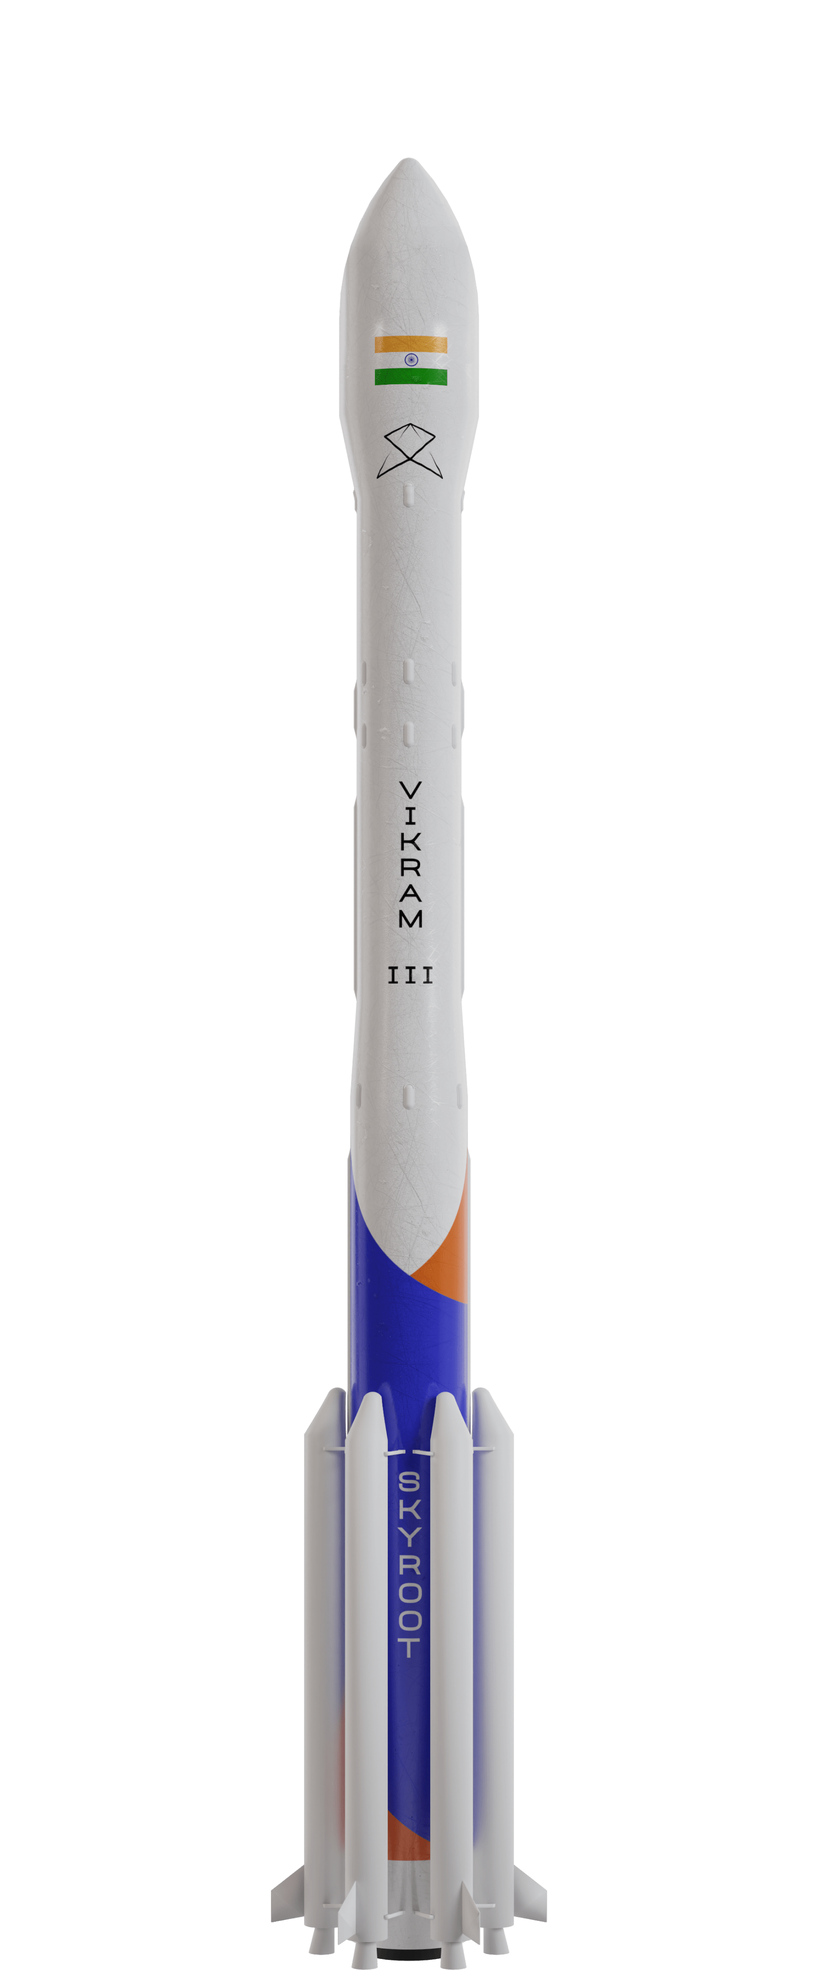
VIKRAM-III
The final and largest version of the Vikram series of rockets is the Vikram-III
It has a payload capacity of 815 kgs.
It is able to put this payload in an low inclination orbit of radius of 500 km.
Similar to the Vikram-II, uses a mix of solid state and cryogenic propulsion systems for lower stage and upper stage propulsion respectively.
The difference between the Vikram-II and the Vikram-III is the addition of 6 SRBs(solid rocket boosters) to the body, giving additional payload capacity

Slide 8
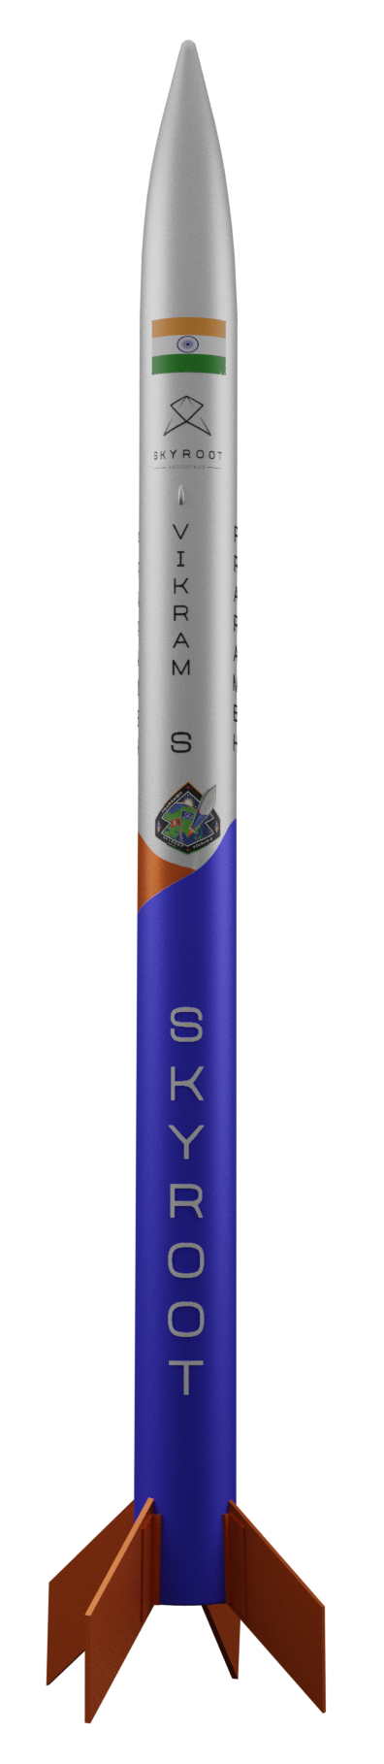
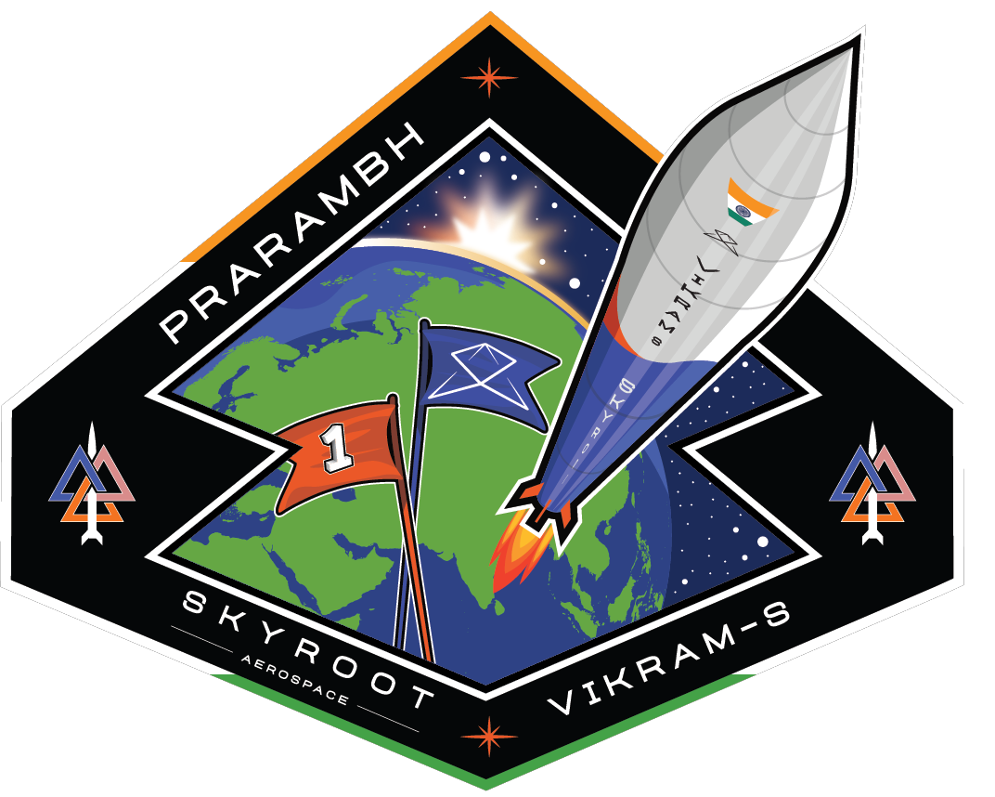
VIKRAM-S: MISSION PRARAMBH
Prarambh is the mission name of Vikram-S, a single stage suborbital space launch vehicle.
Prarambh means the beginning, signifying a new era for the private space sector in India and the first mission for Skyroot. The synergy between Skyroot, ISRO and the Space regulator IN-SPACe forms the bedrock of success for this mission.
With the groundwork starting around late 2020, Vikram-S has been developed within a record time of two years. Vikram-S is powered by the solid-fuelled propulsion, cutting edge avionics and all-carbon fibre core structure.
The Vikram-S will help test and validate majority of the technologies in the Vikram series of orbital class space launch vehicles, including many sub-systems and technologies that will be tested across pre lift-off and post lift-off phases of the launch.

Slide 9
VITAL STATS OF THE FIRST PRARAMBH LAUNCH
PEAK VACCUM THRUST: 7 TONNES
PEAK COMBUSTION PRESSURE: 90 BAR
PEAK VELOCITY CAPABILITY: >MACH 5 (HYPERSONIC)
PAYLOAD CARRIED: 83KGS

Slide 10

The Vikram-S rocket incorporated the company’s own solid stage propulsion system called the Kalam 80 engine.

Slide 11

The Vikram-S features a spin stabilization system to keep the rocket in control which are 3D printed

Slide 12
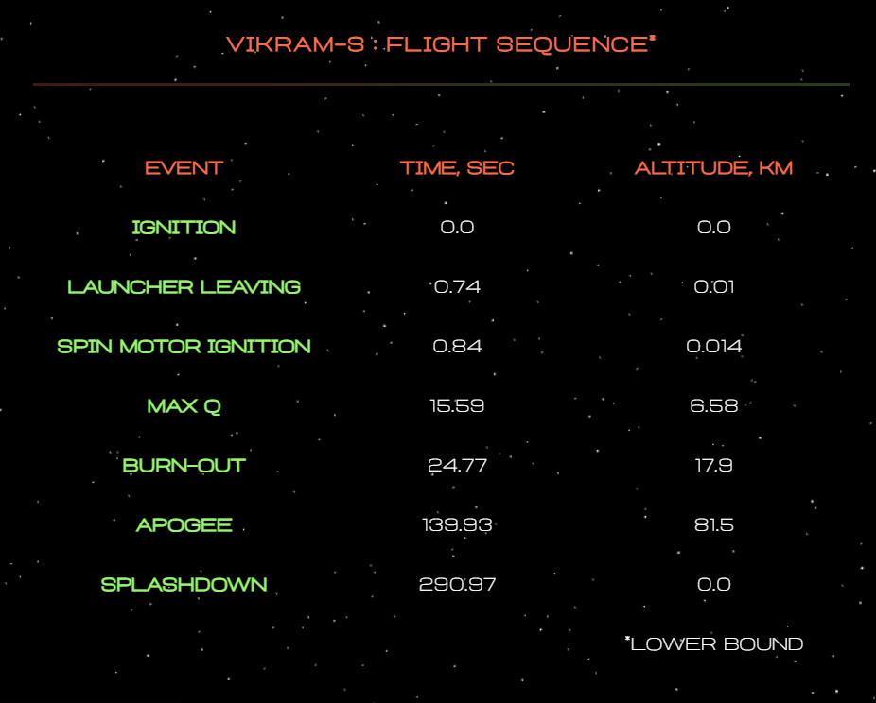
FLIGHT SEQUENCE

Slide 13
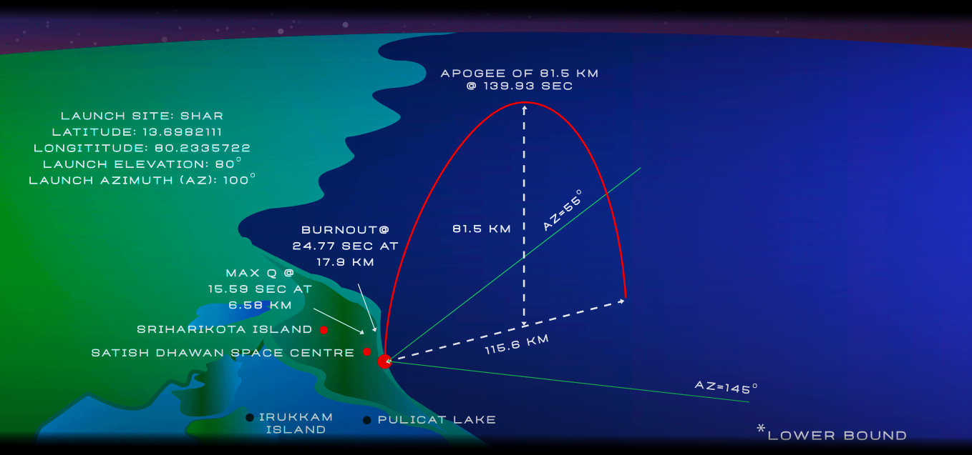
FLIGHT PROFILE

Slide 14
ACHIEVEMENTS AND FUTURE OF THE COMPANY
The company has already launched its rocket, the Vikram-S earlier this month.
This marks the first time that a private space organisation has launched a rocket successfully.
With more ambitious missions, the company aims to dominate the private space organisation sector in our country.

Slide 15


